Slide 1
Project One: People and Places
CUSP 8113
Presented By: Qingyuan Feng

Slide 2
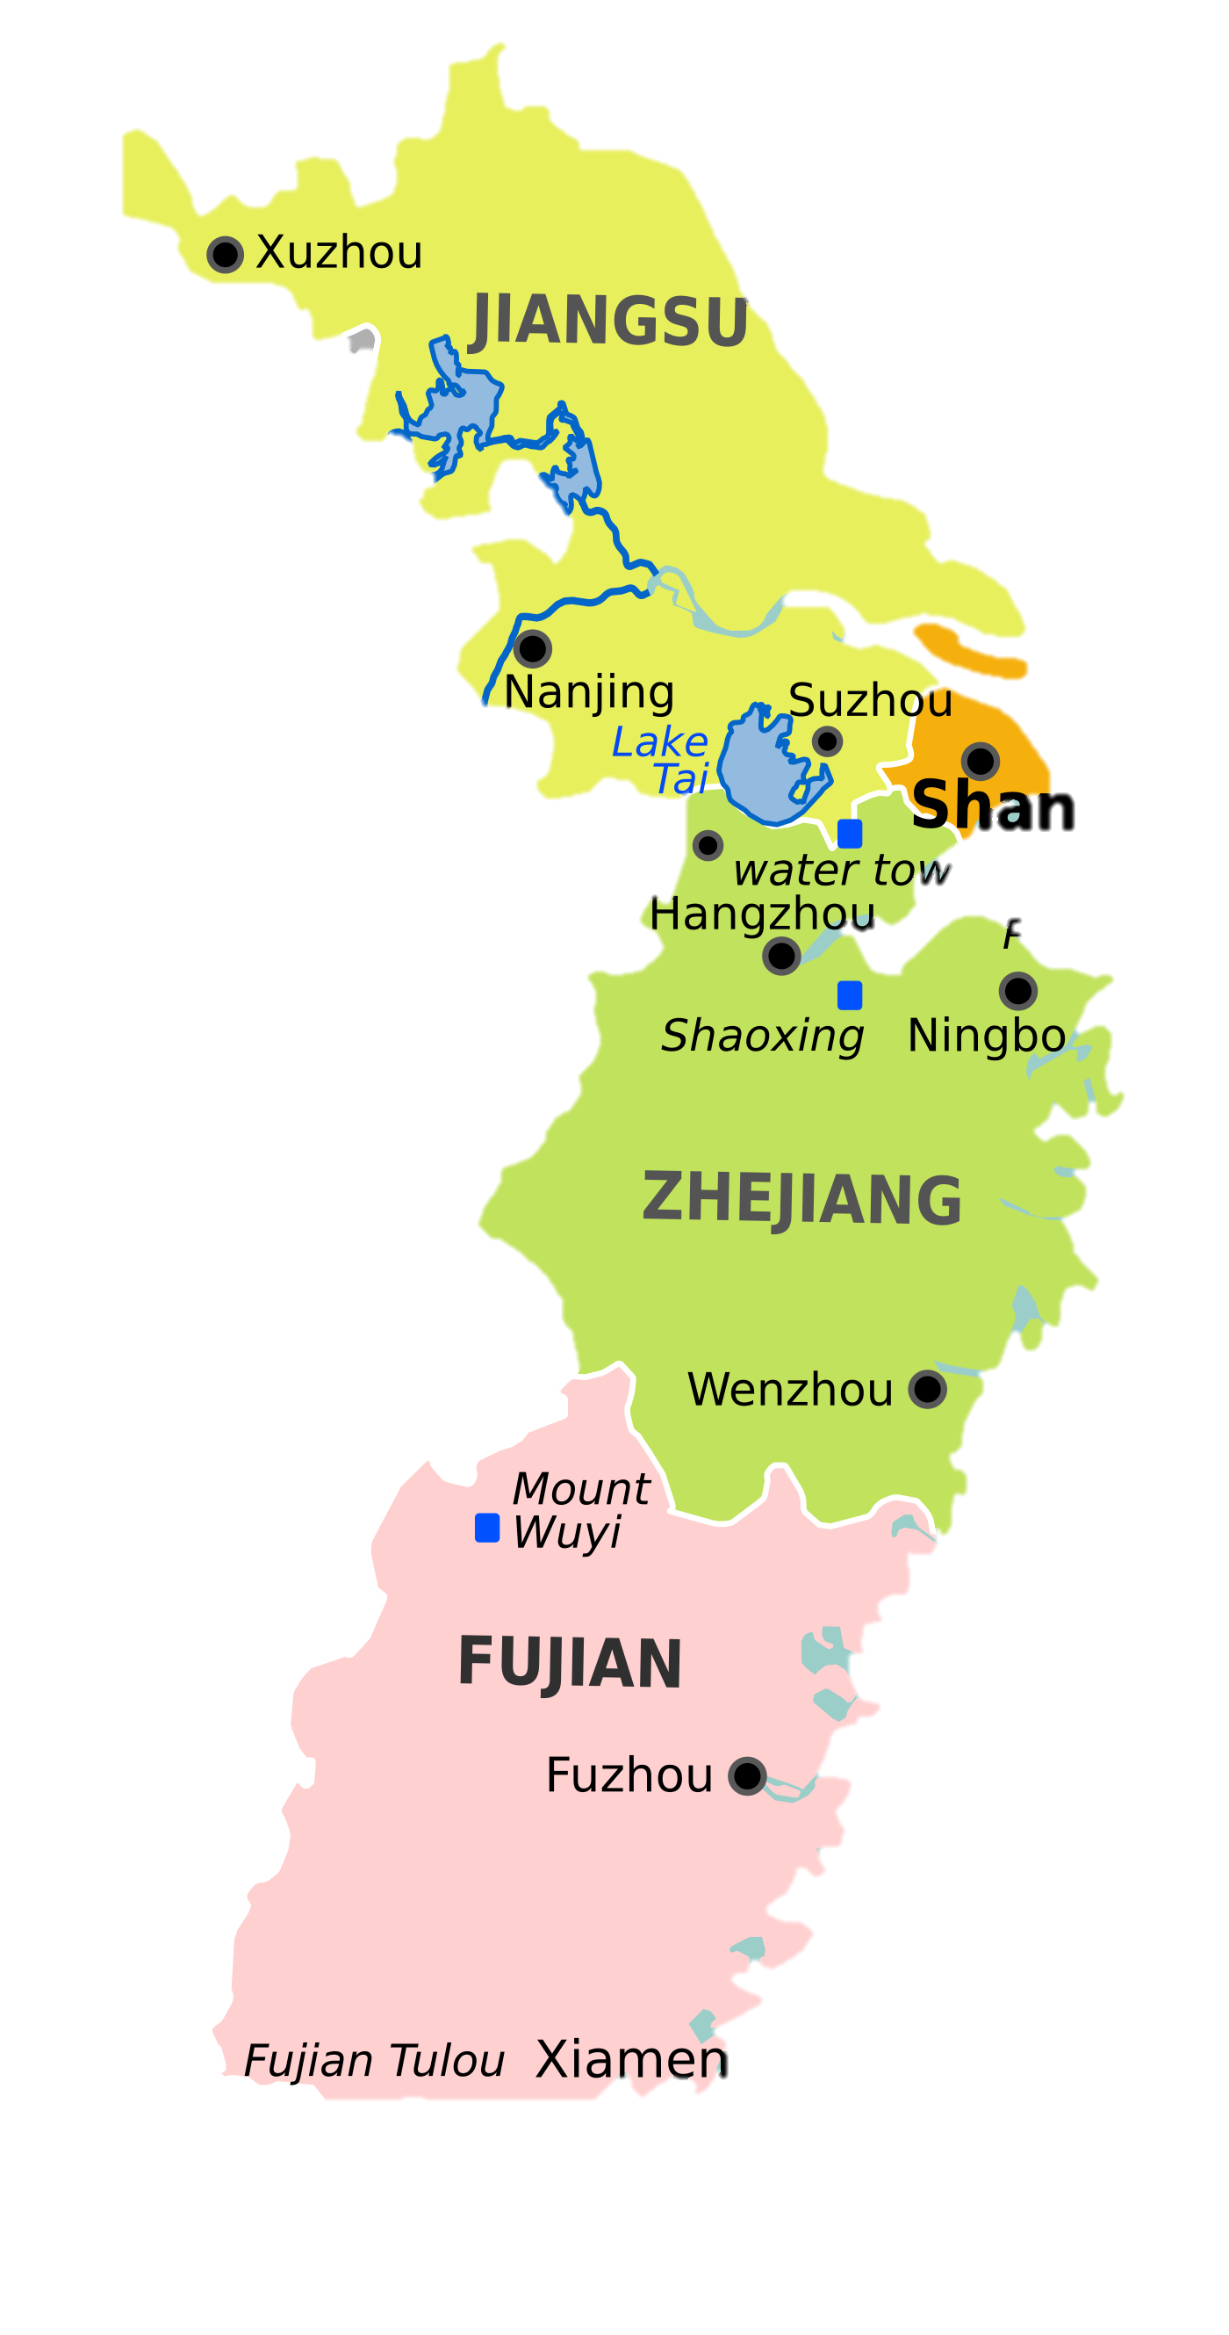
CUSP 8113
Region Of Interest
(around)
Shanghai City, CN
ghai

Slide 3
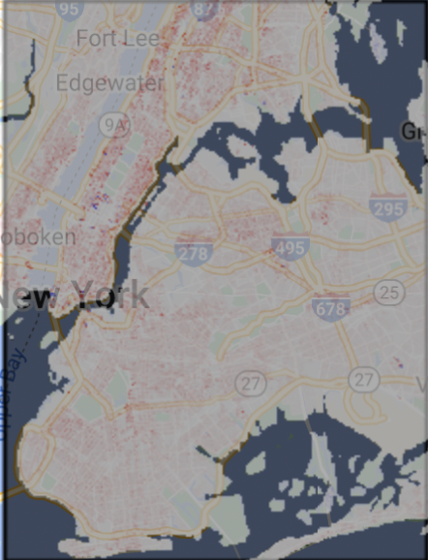

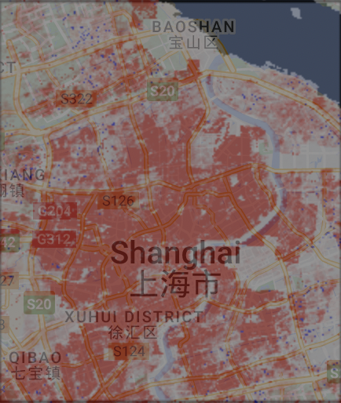
CUSP 8113
Shanghai City
Los Angeles
NYC
Population Change in
Researching Interests: Why Shanghai City
2020-2025(Projection)

Slide 4
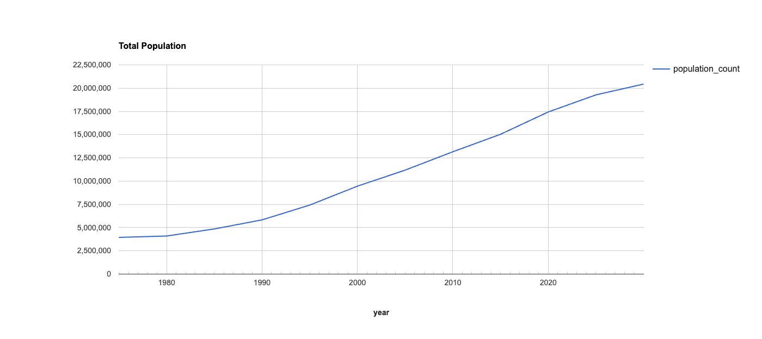
CUSP 8113
Total Population Count

Slide 5
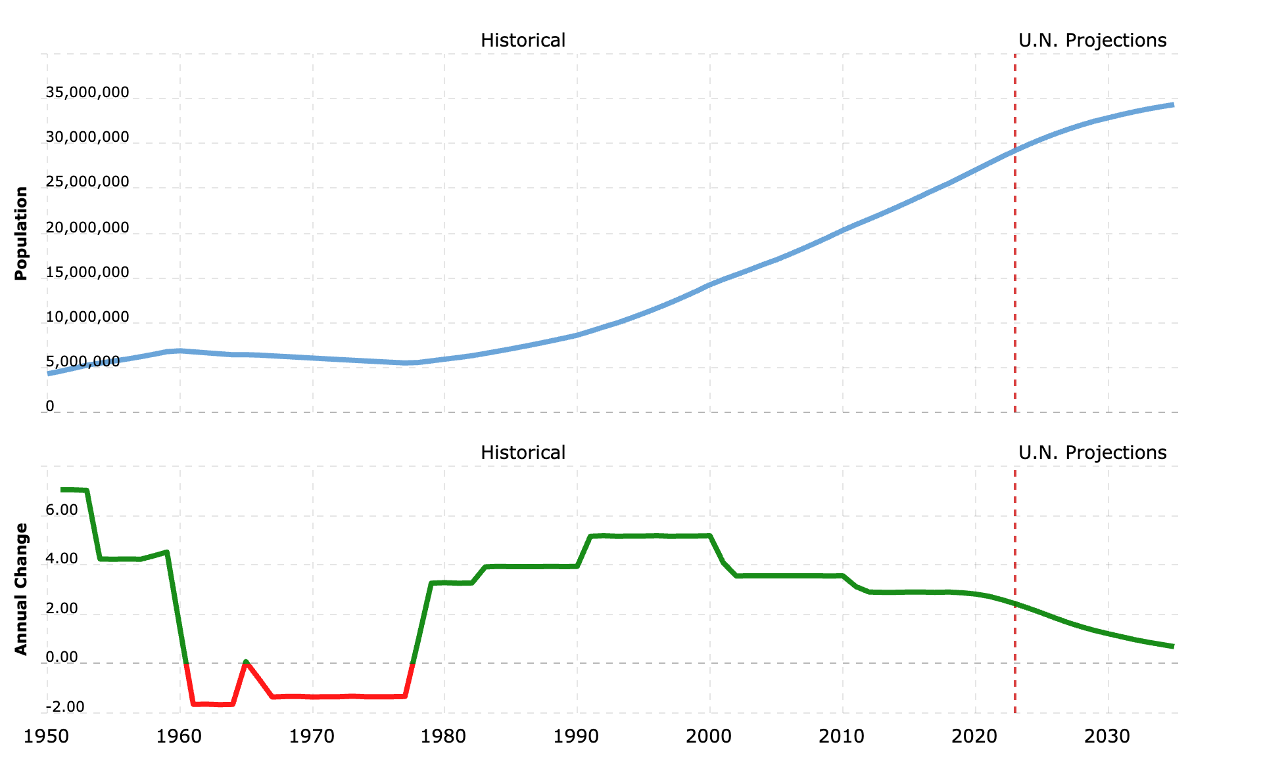
CUSP 8113
Q: Dose Shanghai affected by the Covid-19?
https://www.macrotrends.net/cities/20656/shanghai/population
Notes:
Shanghai City been through a 3-month lock down.

Slide 6
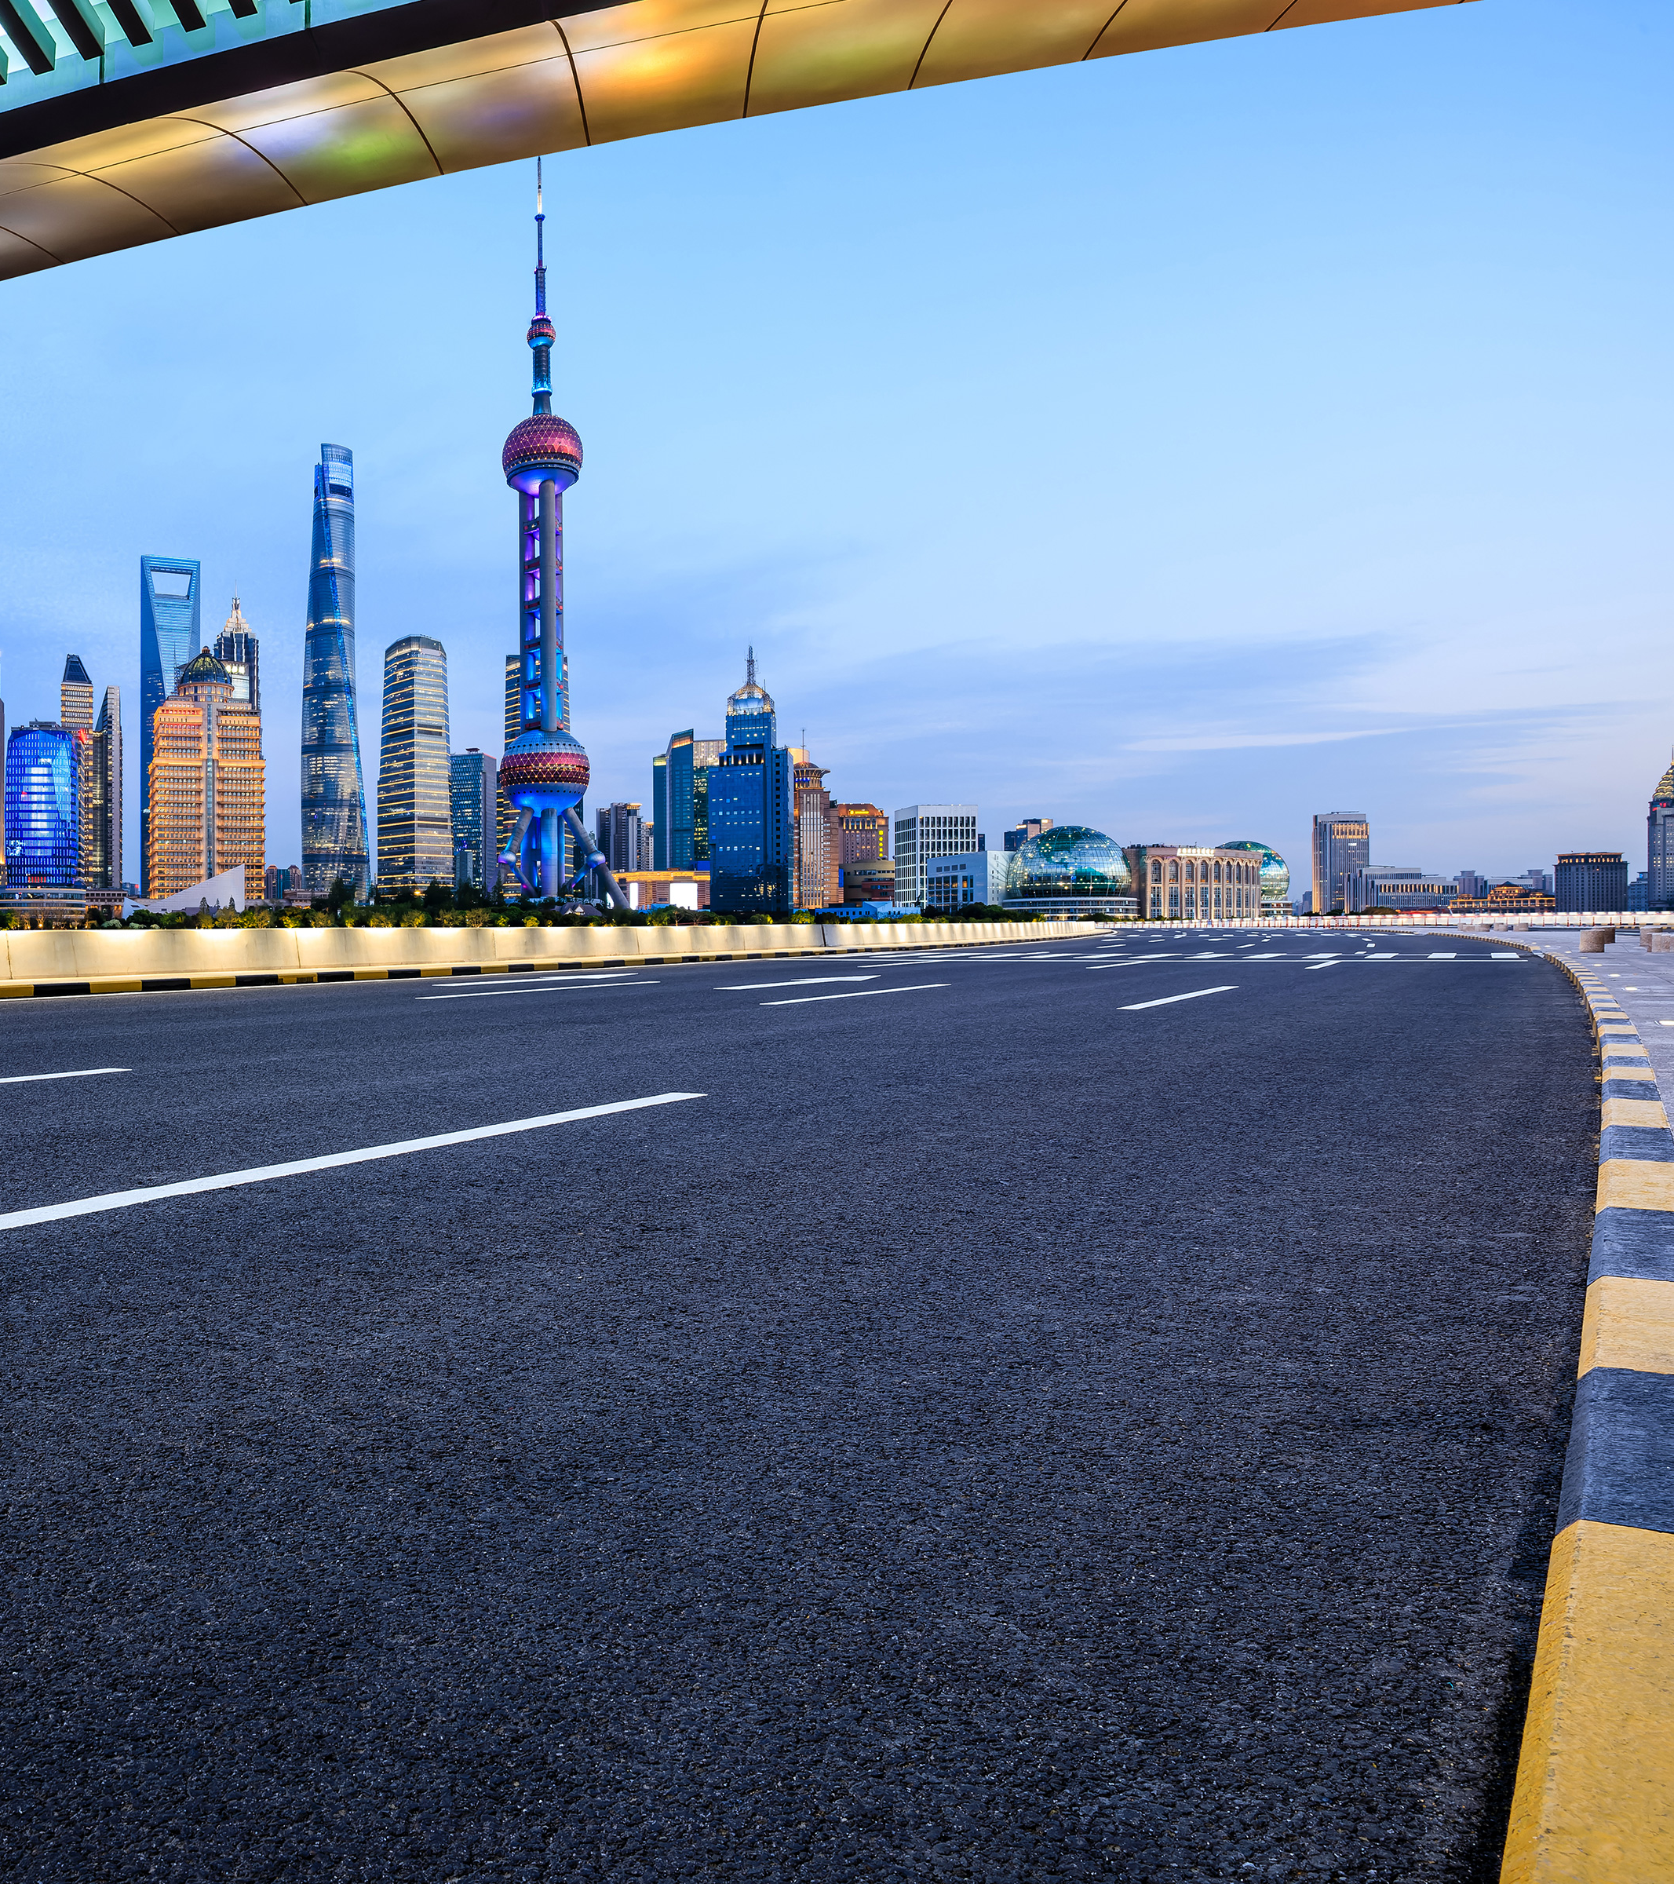
CUSP 8113
Shanghai's birth rate dropped to 4.4 per 1,000 people from 4.7 a year earlier, while its death rate increased to 6.0 per 1,000 people from 5.6 due to a rapidly ageing population…
According to Reuters: Many women in Shanghai were put off having children during a stringent COVID lockdown in April and May last year, which demographers said could have profoundly damaged their desire to have children.
https://www.reuters.com/world/china/shanghais-population-drops-2022-after-covid-lockdowns-2023-03-29/

Slide 7
CUSP 8113
Future Population Growing Trends(til 2035)
https://worldpopulationreview.com/world-cities/shanghai-population

Slide 8
Thanks For Watching
References:
https://code.earthengine.google.com/
https://www.macrotrends.net/cities/20656/shanghai/population
https://www.reuters.com/world/china/shanghais-population-drops-2022-after-covid-lockdowns-2023-03-29/
https://worldpopulationreview.com/world-cities/shanghai-population

